Slide 1
Digital Entrepreneurship for Adult Learners
Training module title:Digital Communication - How to use Digital Communication to boost your business.
By Internet Web Solutions.

Slide 2
INDEX
Unit 1. Digital communication in business environments
1.1 Corporate social media
1.2 Advantages offered by social networks to entrepreneurs and SMEs
1.3 Main tools
Facebook for business
Instagram for business
LinkedIn for business
WhatsApp for business

Slide 3
Unit 1. Digital communication in business environments
1.1 Corporate social media
Social media use, particularly on mobile phone applications, continues to expand regardless of age, gender or ethnicity.
Corporate social networks have brought many benefits to SMEs and are a new focus of interest for technology companies.

Slide 4
Unit 1. Digital communication in business environments
1.2 Advantages offered by social networks to entrepreneurs and SMEs
Better internal and external communication.
Besides e-mail, social networks, WhatsApp and many other technological communication tools, are very important instruments for a company.
Simplifies management.
ICT and Corporate Social Networks enable significant time savings in the completion of tasks and simplify many processes. Actions such as planning, management, organization or business monitoring and control are much faster and more effective when the right tools are used.
Satisfied customers
Management tools provide us with better information about customers, their buying practices, their preferences, their needs and desires, and allow us to design strategies focused on customer satisfaction.

Slide 5
Unit 1. Digital communication in business environments
1.2 Advantages offered by ICTs and social networks.
Expansion
ICTs and social networks are instruments that cross all technological, physical and spatial barriers to benefit the expansion and development of a company, especially in the initial stages.
Better brand image for the company.
ICT tools and corporate social networks project a modern and innovative image of a company, which contributes to making it more efficient and competitive.

Slide 6
Unit 1. Digital communication in business environments
1.3 Main tools
Facebook for business:
A Facebook business page is a free web page that entrepreneurs can build on Facebook to increase their online presence.
How to create a business Facebook page
The first step is to make sure you're setting up the right type of account. You have to create a Facebook page (pages are public profiles that let businesses and public figures connect with friends or followers and, not a Facebook profile (a profile is a personal Facebook account that's designed to share personal information)
To create a Facebook business page, you must have a personal profile and follow Facebook's on-screen instructions.

Slide 7
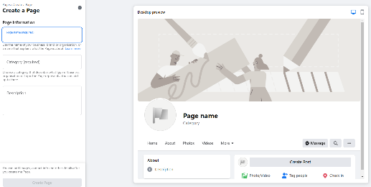
Unit 1. Digital communication in business environments
1.3 Main tools
Profile photo and cover photo.
Choose photos that represent your business well. You can use your logo as a profile photo. For the cover photo, choose an image of your shop, products or website.
Business name and description:
Name your Page as your business or another name that people search for to find your business.
Use the About section to tell people what your business does.

Slide 8
Unit 1. Digital communication in business environments
1.3 Main tools
It´s important to choose the right dimensions for your Facebook Page´s picture and cover photo.
Your Page's profile picture:
Displays at 170x170 pixels on your Page on computers, 128x128 pixels on smartphones and 36x36 pixels on most feature phones.
Your Page's cover photo:
Displays at 820 pixels wide by 312 pixels tall on your Page on computers and 640 pixels wide by 360 pixels tall on smartphones.
Must be at least 400 pixels wide and 150 pixels tall.
Loads fastest as an sRGB JPG file that's 851 pixels wide, 315 pixels tall and less than 100 kilobytes.
For profile pictures and cover photos with your logo or text, you may get a better result by using a PNG file.

Slide 9
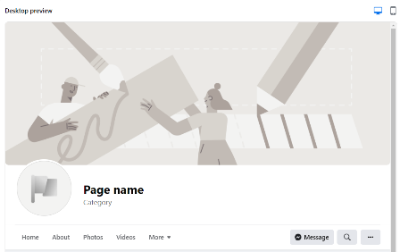
Unit 1. Digital communication in business environments
1.3 Main tools
The action you want people to take
At the top of your Page, you can add a call to action that directs your Page visitors to do something, such as visit your website or phone your shop. It just takes a few clicks.

Slide 10
Unit 1. Digital communication in business environments
1.3 Main tools
Fill in the appropriate page sections.
Home: This is also the first page users see when they visit your page.
About: This should be filled out with your address, business details, contact information, hours and website URL.
Community: The Community page is where posts, photos and videos from customers show up.
Events: You can create event pages and promote upcoming events in this section. Once you create an event on Facebook, you can invite people and share specific information about it all in one place.

Slide 11
Unit 1. Digital communication in business environments
1.3 Main tools
Info and Ads: This section is designed to add transparency to your page. It shows your followers any Facebook ads you're currently running.
Offers: You can post discounts or deals from this section.
Posts: This section shows all of your posts, including timeline photos and updates.
Reviews: Customers can write a review and indicate if they would recommend your business.
Services: You can showcase your services on this page. You can also add information about your speciality, including a photo, a description and pricing.

Slide 12
Unit 1. Digital communication in business environments
1.3 Main tools
Photos: The Photos tab features the images you've posted on your timeline.
Shop: You can add your inventory on this page, and users can buy your products directly from Facebook. Sales are sent to your bank account.

Slide 13
Unit 1. Digital communication in business environments
1.3 Main tools
Instagram for business:
Instagram is one of the most popular social media platforms, with nearly 112.5 million users in 2020. From gathering insights to selling products, Instagram keeps rolling out tools to help business owners succeed on the photo-sharing social media platform.
How to create an Instagram business profile
Download the Instagram app for iOS, Android or Windows.
Click Sign up.
Enter your email address. It's better to use your business email. You can also log in with Facebook for business.
Choose a username and password.
Now you have a "personal" Instagram account that can be converted to a business profile.

Slide 14
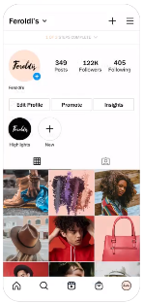
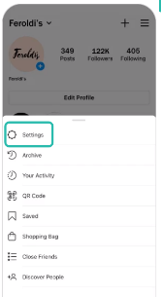
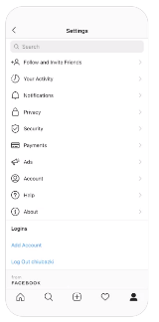
Unit 1. Digital communication in business environments
1.3 Main tools
How to convert a personal Instagram profile to a business profile:
1. Press the three bars in the upper right-hand corner
2. Press Settings
3. Press Account

Slide 15
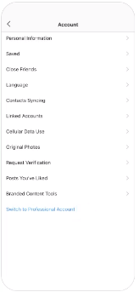
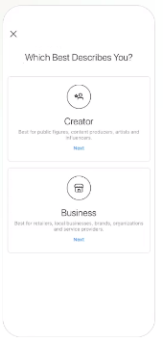
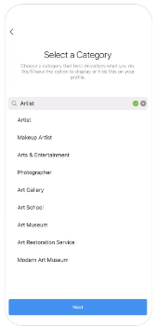
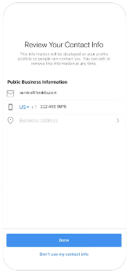
Unit 1. Digital communication in business environments
1.3 Main tools
6. Select a Category
7. Review your contact info
4. Switch to Professional Account
5. Select Creator / Business account

Slide 16
Unit 1. Digital communication in business environments
1.3 Main tools
How to use Instagram for business.
Add high-quality photos. Take time to take and edit photos.
You can find free editors and filters apps:
VSCO: Photo & Video Editor
Snapseed
Photoshop Express Photo Editor
A Color Story
Adobe Lightroom: Photo Editor
Create Instagram Stories. On Instagram Stories, you can post videos, photos, text, and music. You can also add stickers such as your location, user tags and hashtags.

Slide 17
Unit 1. Digital communication in business environments
1.3 Main tools
Stream live videos. You can give customers a live look behind the scenes at aspects of your business, show products or answer live questions through comments.
Engage with your followers. Double-tap the image or tap the heart button below the post to express your liking of a photo. Comment on photos and mention them using the @ symbol to tag other users.
Use hashtags # to help users find content on Instagram. It's a good idea to look at other brands in your industry for examples of what hashtags to use.

Slide 18
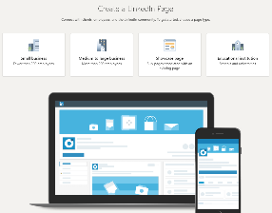
Unit 1. Digital communication in business environments
1.3 Main tools
LinkedIn for business:
LinkedIn is the most popular social networking site when it comes to online business networking.
LinkedIn for business can help your business find and recruit top talent.
You can create and share posts that are relevant to your followers.
You can create showcase pages to promote your products and brands.
How to create a business page in 3 steps
First step. Select your business type.

Slide 19
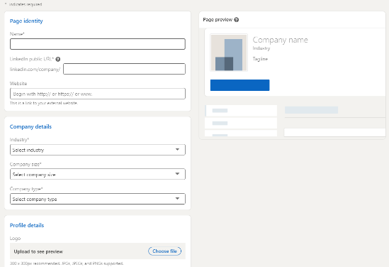
Unit 1. Digital communication in business environments
1.3 Main tools
Second step. Add company details.

Slide 20
Unit 1. Digital communication in business environments
1.3 Main tools
Third step. Add a logo.
Your logo should be 300 x 300 pixels and
can be a JPG or PNG file.

Slide 21
Unit 1. Digital communication in business environments
1.3 Main tools
Tips for using your LinkedIn page
Get followers
Publish relevant content.
Publish videos and photos.
Create LinkedIn Showcase Pages
tip
tip
tip
tip

Slide 22
Unit 1. Digital communication in business environments
1.3 Main tools
WhatsApp for business:
The WhatsApp Business app was built with the small business owner in mind. With the free-to-download app, businesses can interact with customers easily by using tools to automate and quickly respond to messages.
Get started with the WhatsApp Business app
Download the app.
Get started by downloading the WhatsApp Business app and following the prompts to register your phone number.
iOS: https://apps.apple.com/app/whatsapp-business/id1386412985
Android: https://play.google.com/store/apps/details?id=com.whatsapp.w4b

Slide 23
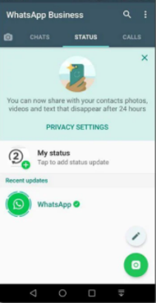
Unit 1. Digital communication in business environments
1.3 Main tools
Log in to Business Manager and click Business settings in the top right.
Below Accounts, click WhatsApp accounts and click Add.
On the Create WhatsApp account screen, enter a name for your business below Account name.
In the Messaging for box, there are two options: Option 1: Select Your account to create a business account for yourself.
Option 2: Select Client's account to create an account on behalf of a business. Enter its Business Manager ID, which you can find in its Business Manager settings.
5. Below Time zone, select the time zone where your business is located.
6. Under Local currency, select the local currency of your business.

Slide 24
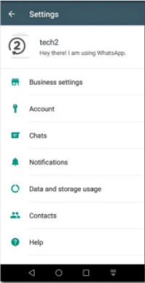
Unit 1. Digital communication in business environments
1.3 Main tools
7. The currency you enter must match with the currency in which you plan to pay your invoices.
8. Below Payment method, select a method of payment for your ads. If you don't have a current line of credit for payment, you can set one up.
9. Below PO number, enter the purchase order (PO) number that will appear on your invoices.
10. Below People, search for people you want to add to the account or choose them from the list.
11. Select the role you'd like to assign to each person.
Admin access allows people to make any changes to the account.
Standard access allows people to manage phone numbers, edit message templates and see metrics.

Slide 25
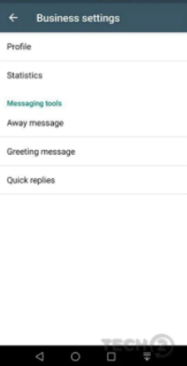
Unit 1. Digital communication in business environments
1.3 Main tools
Create a business profile.
To set up your WhatsApp business profile, add a photo representing your business, your business name, phone number, email address, website and a brief description.
Start messaging.
Use WhatsApp Business to do all the things that you're used to using WhatsApp for – from messaging and sending photos to making voice and video calls.

Slide 26
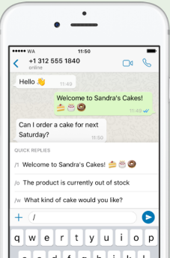
Unit 1. Digital communication in business environments
1.3 Main tools
Scale your responses with custom messaging tools.
Create a greeting message to automatically introduce customers to your business, set an away message when you're unable to answer or save time with quick replies to re-use answers to frequently asked questions.
Quick Replies
Quick replies lets you save and reuse messages you frequently send, so you can speedily answer common questions.

Slide 27
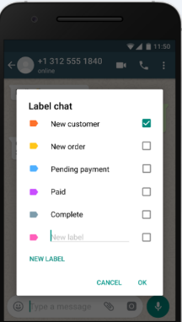
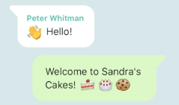
Unit 1. Digital communication in business environments
1.3 Main tools
Labels
You can organize your contacts or chats with labels, so you can easily find them again.
Automated Messages
You can create a greeting message to introduce your customers to your business. You also can set an away message when you are unable to answer so your customers know when to expect a response.

Slide 28
Thank you!

