Slide 1
WEBSITE CREATION
Digital Entrepreneurship for Adult Learners

Slide 2
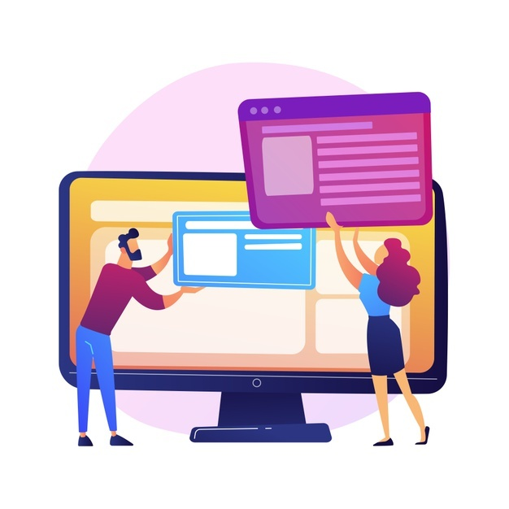
1.1 Definition
The website creation is the process of building webpages involving layout, content and graphic design.

Slide 3
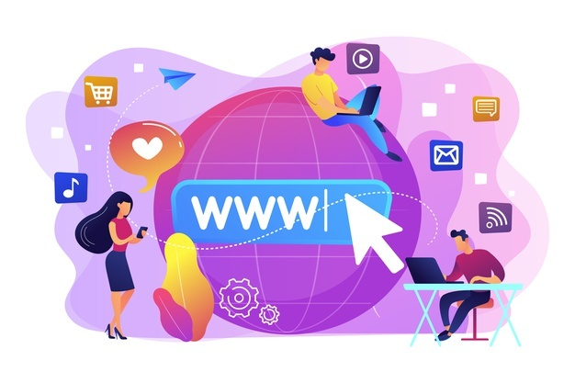
1.2 Essential Knowledge
1. You can no longer survive in any business without a web presence.
2. Your website is the most important part of your interface with your potential customers. Choosing how to go about the design of your website is up to you.
3. Every website needs a "host," a server where all of the data is stored for the public to access at all times.

Slide 4
1.2 Essential Knowledge
4. A good website is more than a static home page. You'll want to create a few pages dedicated to different aspects of your business, such as a detailed catalogue of your products or services, or a blog section for company updates. Don’t forget to include your contact details!
5. Start by asking yourself what you want from an online store and put yourself in the shoes of a potential visitor to your online store.

Slide 5
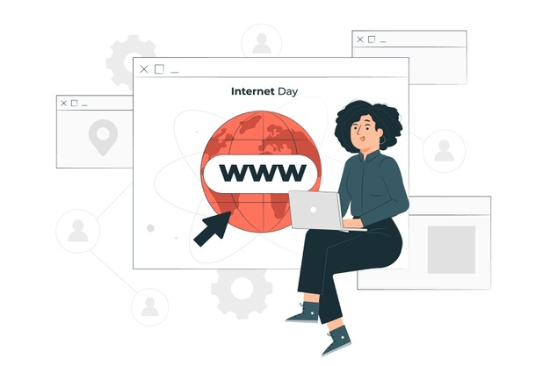
1.2 Essential Knowledge
6. Add a Privacy and Cookies Policy
7. Before you build your site, check out your competitors and note what they do well. If you like the look and feel of another site, there’s no reason not to start with something you like. Do not copy it: adapt it and make it your own.
8. It is becoming the norm to have package tracking to notify customers of the whereabouts of their order and critically when the item will arrive. In the long run it reduces costs (less complaints) and enhances the reliability of your company by meeting customer expectations.
9. Your choice of domain name is very important and you must register it. You want your domain name to be descriptive and easy to remember.

Slide 6
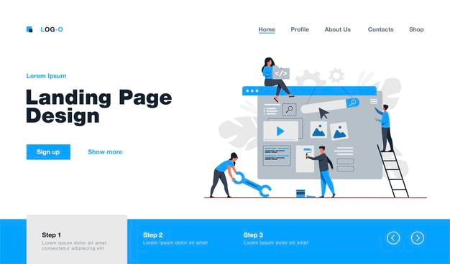
1.3 Practical Tips
If you are a small startup Digital Entrepreneur you do not need to build a website that can handle lots of traffic. What you need is a site that has a few pages where potential customers can find out about your business and make a purchase.
You then can decide if you want to build the website yourself or hire a professional website builder. If you decide to build one yourself you can download a template and start on the content. However this can take time and the result may fall below professional standards. First impressions are very important and if your website looks amateurish compared to your competitors that will make the wrong impression.

Slide 7
1.3 Practical Tips
The most important thing you must do is say, on the home page in plain terms, what your company does. Make sure customers can discover within a few seconds of opening your site if your company can deliver what they need. Put yourself in your customers’ shoes. They want easy navigation and a user friendly structure.
If relevant, include a reference to your awareness of environmental concerns and how your company addresses them (especially if you are a food producer).
Your web address (URL) should be easy to remember.

Slide 8
1.3 Practical Tips
Include a link where customers can sign in for regular updates (ask their permission first!)
Avoid pop-ups. Pop-up windows are distracting. Shoppers tend to regard them as a nuisance and usually dismiss them immediately.
Once consumers find the products or services they are seeking, make sure they get all the information that’s made available by manufacturers. Include multiple high-definition images to provide shoppers with as close to a real-world experience as possible. The use of white background typically works well because it helps products stand out.

Slide 9
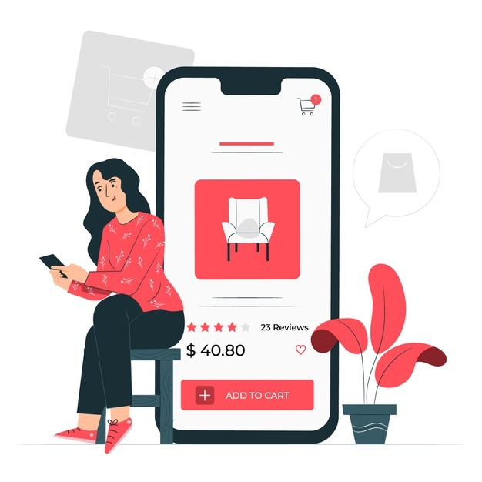
1.3 Practical Tips
A hit counter is recommended. This tells you how many people have visited your webpage, website, or blog site. While not perfect, it is a useful tool in analysing how popular your site is.
Try to keep the use of different colours, font faces, and sizes to a minimum. To bring clarity to the content, use contrasting colours for the text and the background.

Slide 10
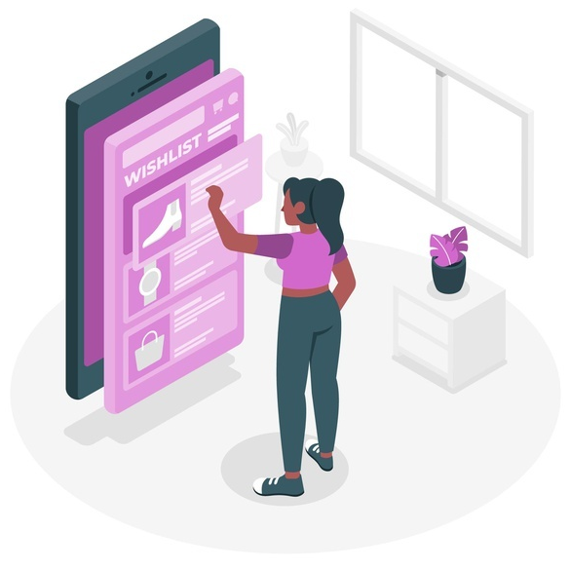
1.3 Practical Tips
Consider adding a ‘Wish List’, a gift voucher facility for customers.
Observe general business ethics i.e. no misrepresentations!
If unsure of your own site building ability, hire a professional web designer.

Slide 11
Thanks!
Any questions?

