Slide 1
Identify and Face Virtual Threats
By Irish Rural Link

Slide 2
Objectives and Goals
At the end of this unit you will be able to:
Understand the challenges and risks of Internet use
Identify Virtual threats
Protect Devices & Personal Data

Slide 3
Smart Ways to Protect your Personal Data
Make It Harder for Other People to Get Credit in Your Name
Put Passwords on Your Devices
Use Stronger Passwords
Set up Two-Factor Authentication on Your Financial and Email Accounts
Don't Do Your Online Shopping and Banking at the Local Cafe
Update Your Software Regularly
Don't Give Out Personal Information on the Phone or Through Email or Text
Be Careful About Opening Email Attachments or Clicking Links

Slide 4
What is the greatest risk
A company's web presence includes
its website but also social media,
blogs, and advertising.
The primary objective of building
a web presence is presenting
the company to as many people as
possible to increase sales.
The greatest risk is compromised security

Slide 5
Top 10 Internet Safety Rules & What Not to Do Online
Keep Personal Information Professional and Limited
Keep Your Privacy Settings On
Practice Safe Browsing
Make Sure Your Internet Connection is Secure
Be Careful What You Download
Choose Strong Passwords
Make Online Purchases From Secure Sites
Be Careful What You Post
Be Careful Who You Meet Online
Keep Your Antivirus Program Up To Date

Slide 6
Protecting Devices How to set/secure a password in Pcs Click the start button at the bottom of the screen Click Settings from the list to the left Select Accounts Select sign – in options from the menu Click on change under Change your account Fill in the fields, press Next and Finish Please Note Do use a combination of uppercase and lowercase letters, symbols and numbers. Don’t use commonly used passwords such as 123456, the word. The word “ password”, “qwerty”,”11111”, or a word like, “monkey”. Do make sure your user passwords are at least eight characters long.

Slide 7
Antivirus Software To keep your computer and your files safe from viruses and other threats, you need to use antivirus software that will provide full protection at any given time. Antivirus software detects and removes viruses on computers and networks. Modern-day antivirus software protect your devices against malware without affecting their speed and performance.

Slide 8
What is Antivirus Software?
Antivirus software is an application or a suite of programs that finds and removes viruses on computers and networks.
In addition to viruses, most of today’s antivirus programs are also capable of detecting and removing other types of malicious software, including worms, Trojans, adware, spyware, ransomware, browser hijackers, keyloggers, and rootkits.
Besides being able to identify and remove these threats, the best antivirus software can also prevent them from infecting your system.

Slide 9
Tips to protect your computer
Use a firewall
Keep all software up to date
Use antivirus software and keep it current
Make sure your passwords are well-chosen and protected
Don't open suspicious attachments or click unusual links in messages
Browse the web safely
Stay away from pirated material
Pharming
Rogue Security Software

Slide 10
Antivirus Recommendations
The 7 Best Antivirus Software of 2021
Best Overall: Bitdefender Antivirus Plus.
Best for Windows: Norton 360 With Life Lock.
Best for Mac: Web root Secure Anywhere for Mac.
Best for Multiple Devices: McAfee Antivirus Plus.
Best Premium Option: Trend Micro Antivirus+ Security.
Best Malware Scanning: Malwarebytes.

Slide 11
Windows Antivirus Installation
How to install antivirus on computer
Open the antivirus program.
Look for a Settings or Advanced Settings button or link in
the antivirus program window.
If you do not see either option, look for an option like Updates
or something similar.
In the Settings or Updates window, look for an
Option like Automatically download and
apply updates.

Slide 12
Windows Antivirus
When we install an antivirus it is often configured and ready to start, but it is always advisable to check that the settings are the ones we need.
We are using Windows Defender on this version for Windows 10.
When we install or run a computer with Windows 10 we already have our PC protected because Windows Defender is installed within the OS.

Slide 13
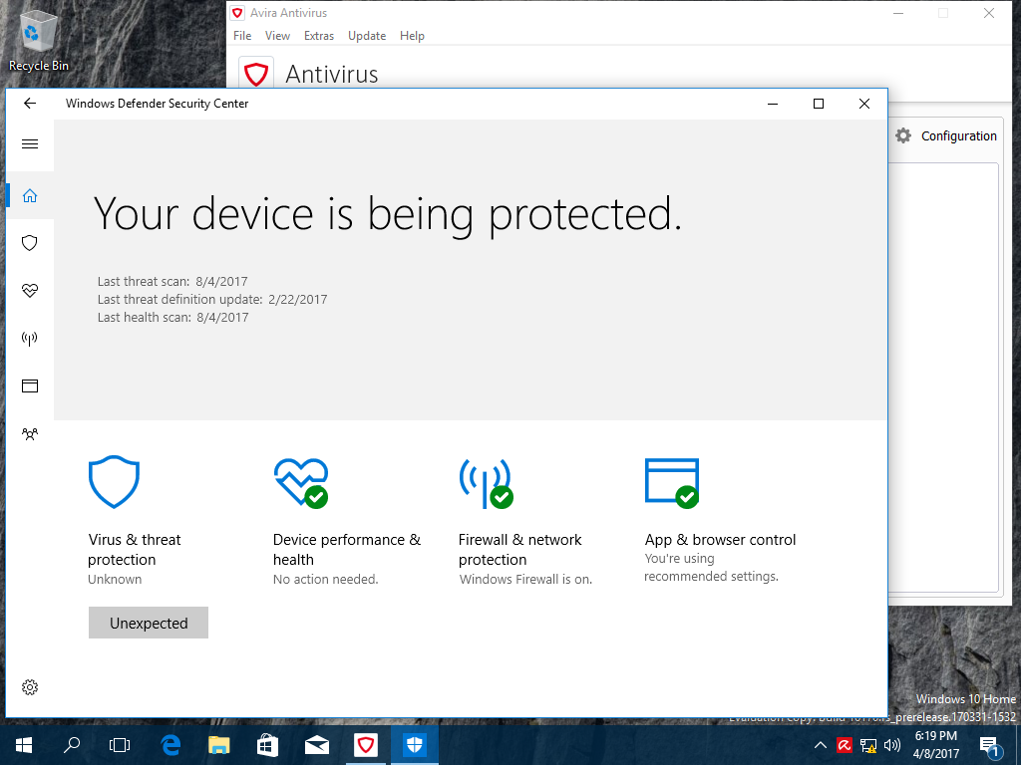
Protecting your PC
The following is the configuration process of Windows defender for Windows 10:
https://www.youtube.com/watch?v=HH0xdWpckZY

Slide 14
Thanks!
Any questions?

