Slide 1
Basic Introduction to Computer Technology
By Irish Rural Link

Slide 2
Objectives and Goals
At the end of this module you learn about
Basic Computer Technology
Microsoft Word & Excel

Slide 3
Unit 1 Computing Devices
In the recent past the vast majority of people used a Personal Computer (PC) to access the Internet. Recently however the number of people using only a PC to browse the internet has declined rapidly.
An ever expanding number of devices are now used to connect to and use the Internet. Some of the most popular computing devices are outlined in the few slides.

Slide 4
Unit 1
Introduction to Basic Computer
Technology
Unit 2
Introduction
to Software,
Microsoft Word & Excel

Slide 5
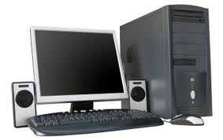
Unit 1 Desktop PC with Speakers
Personal Computer
Traditionally the PC was the most popular method used to browse the Internet.
The Desktop version of a PC is a relatively large device and usually has a monitor, a mouse and a keyboard attached.

Slide 6
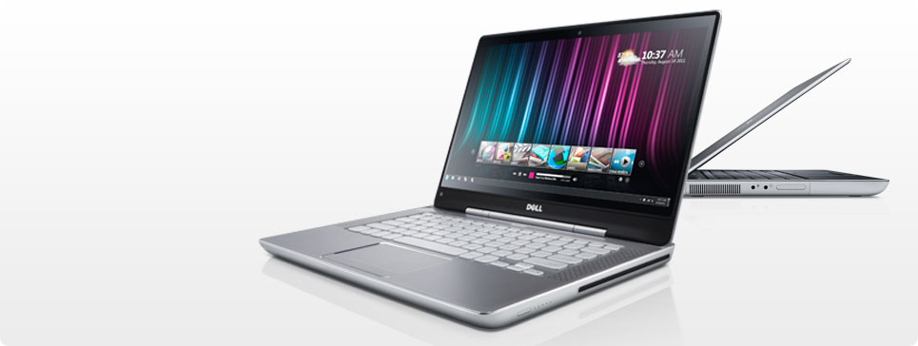
Unit 1 Laptop
A laptop is simply a smaller version of a Personal Computer and has a built in monitor, keyboard and mouse. A laptop may also have built in speakers and microphone.
It is much easier to transport a laptop than a desktop and as a result laptops are more popular than PC’s.

Slide 7
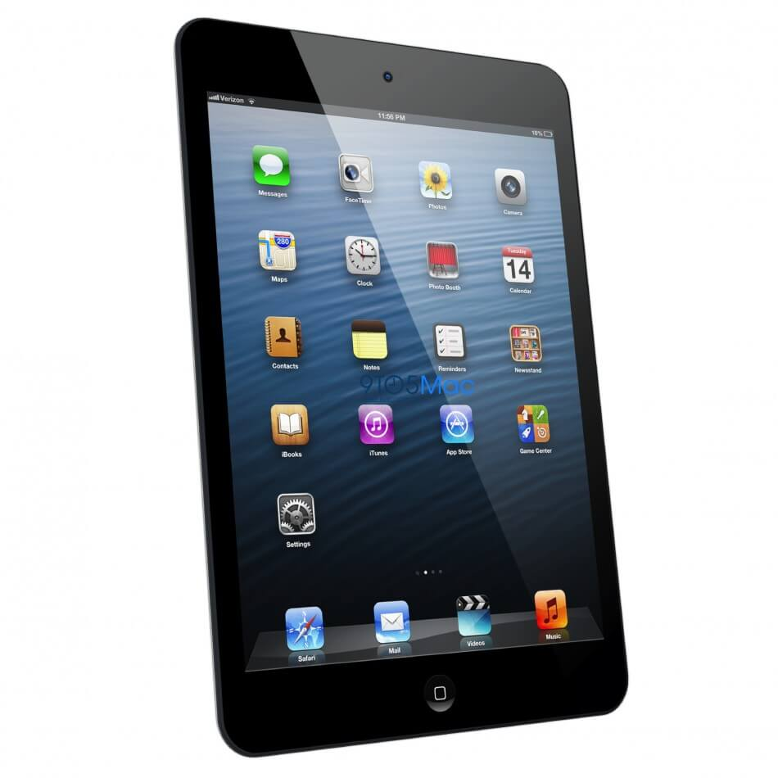
Unit 1 Tablet/iPad
A tablet is a small, thin, flat tablet-sized personal computer which has many of the features of a full-size computer.
While tablets have been around for quite a while, they have not been widely used in business or in the home. However, the release of the Ipad has made tablets a household name.

Slide 8
Unit 1 The Monitor
The monitor is attached to the systems unit but is not permanently connected, it can be moved from one computer to another quite easily.
Flat screen monitors come as standard and their function is to display the activity of the computer.

Slide 9
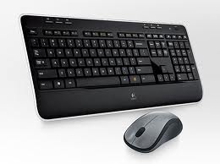
Unit 1 Mouse and Keyboard
Other necessary hardware includes the mouse and the keyboard.
The mouse is used to enter commands into the computer and the keyboard is used to type information and commands into the computer.

Slide 10
Unit 2 Software
Software is the term given to the programs used by a computer, for instance if you have a game on your computer, the game is considered software. If you were to buy a computer with absolutely no software loaded you could not use the computer for much more than a door stop. The usefulness of your computer increases as you add more software.
For now we will consider 2 types of software, Application software and Operating System

Slide 11
Unit 2 Software
Application Software
Application software is software that allows the user to do specific actual work such as typing letters, creating spreadsheets and databases etc.
Examples of application software are Microsoft Word (used to type letters), and Microsoft Excel (used to create spreadsheets) and Internet Explorer (used to browse the web).

Slide 12
Unit 2 Operating System
Most application software cannot communicate directly with hardware, it needs a middle man to translate and communicate between the two items.
This middle man is known as an operating system, it sits on top of the hardware and facilitates communication with the Applications software.

Slide 13
Unit 2 Operating System
The most well known operating system for home users is Windows and the most recent version of Windows is Windows 10
Previous versions included Windows Vista and Windows XP
Application Software (Word, Excel etc)
Operating System (Windows)
Hardware (The Computer)

Slide 14
Unit 2 What is Microsoft Word
Microsoft Word or MS Word is a popular word processing program used mainly for creating documents, such as brochures, letters, learning activities, quizzes, tests, and students' homework assignments. It was first released in 1983 and is one of Microsoft Office suite's applications.

Slide 15
Unit 2 Open a Word Document
Right-click the file you want to open.
In the pop-up menu, select the Open with option.
If available, choose the Microsoft Word program option in the Open with menu.
If Microsoft Word is not listed, select the Choose other app or Choose default program option, depending on the version of Windows on your computer

Slide 16
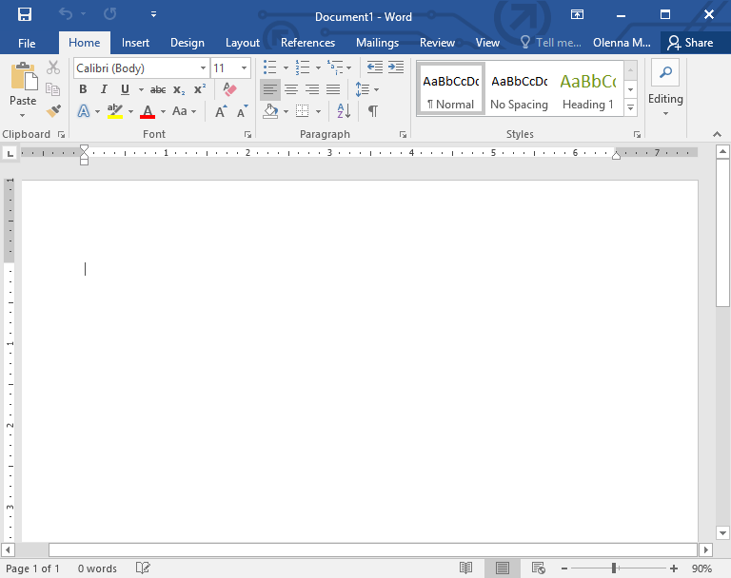
Unit 2 Word /Toolbars
You can change the shape of letters, bold letters, colour, tilt, or even underlined

Slide 17
Unit 2 Word /Toolbars You can select the font type and size.

Slide 18
Unit 2 Word /Toolbars
You can place the text/picture left, middle, right or justified position.

Slide 19
Unit 2 Word /Toolbars
You can list the content in different ways.

Slide 20
Unit 2 Word /Toolbars
You can define the lines-pace

Slide 21
Unit 2 Word /Toolbars
You can highlight the text with colouring

Slide 22
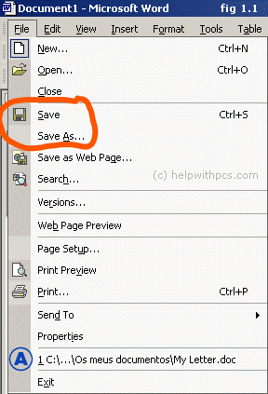
Unit 2 Saving a Document
Click to the file on the tab of the
Layout and choose save option
In the window that appears you
Choose where to save the document

Slide 23
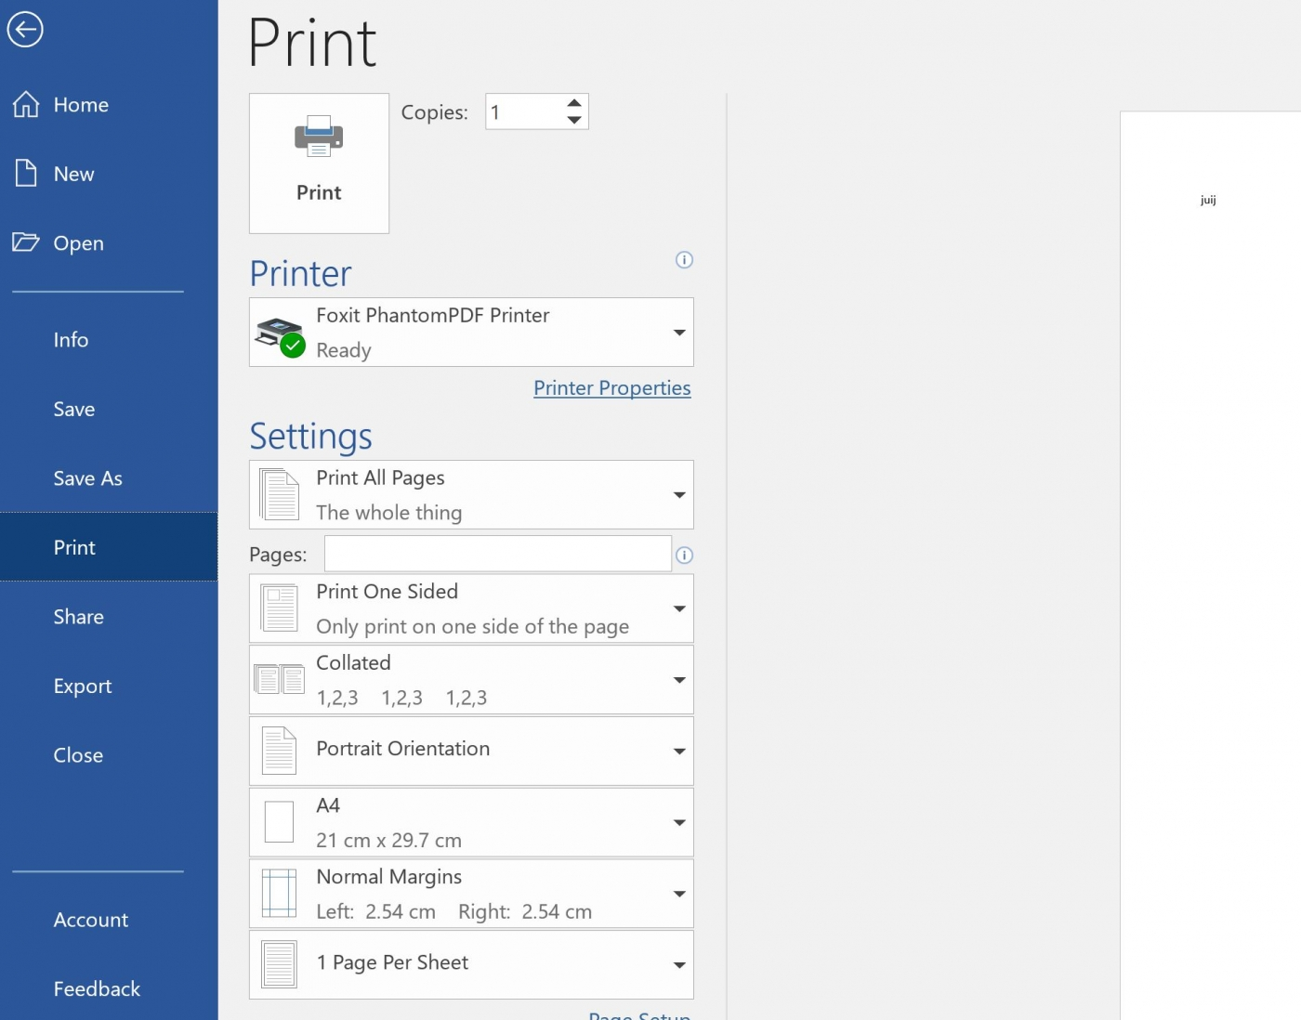
Unit 2 How to print
Select Print
from the File tab
to print.

Slide 24
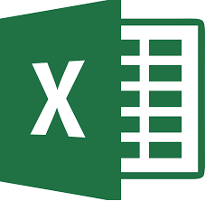
Unit 2 Introducation to Excel
Excel is typically used to organize data and perform financial analysis. It is used across all business functions and at companies from small to large.

Slide 25
Unit 2 How to Open Excel
Click the Excel button in Start menu
(left bottom corner).
Select new blank spreadsheet. The new spreadsheet dialog box appears.
You should click/select the cell you want to work with.

Slide 26
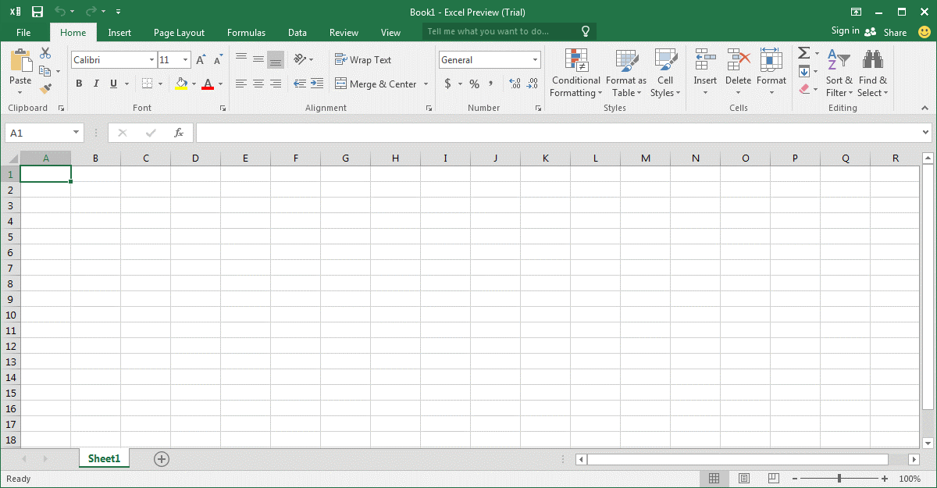
Unit 2 Spreadsheet /Toolbars
Before or after typing you can shape the letters bold, colored, tilted, or even underlined.

Slide 27
Unit 2 Spreadsheet /Tools Select the font type and size.

Slide 28
Unit 2 Spreadsheet /Toolbars
You can colour the cells too.

Slide 29
Unit 2 Spreadsheet /Toolbars You can choose borders

Slide 30
Unit 2 Spreadsheet /Toolbars Text can be put in alphabetical order.

Slide 31
Unit 2 Spreadsheet /Toolbars You can summarize the inserted numbers of the selected cells.

Slide 32
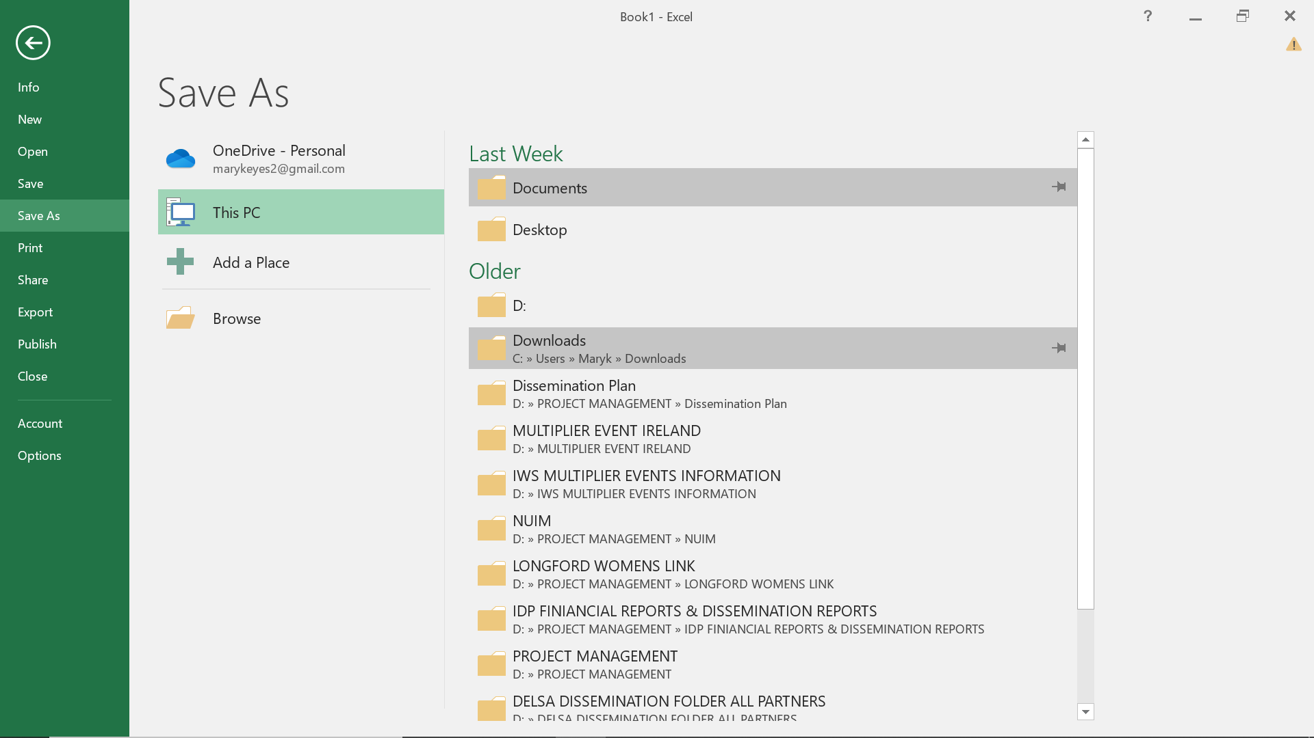
Unit 2 How to save your spreadsheets
Click to file on the top of the
layout and choose save option.
In the window that appears
you can choose where to
save the document.

Slide 33
Thanks!
Any questions?

