Slide 1
Critical Thinking
in a Digital Era
By HAC

Slide 2
Objectives and Goals
At the end of this module you will be able to:
Exercise your critical thinking
Use series of questions to reflect on your thinking
Spot false information​

Slide 3
Index
Unit 1
Unit 2
How can we think critically?​
Critical thinking in a digital era

Slide 4
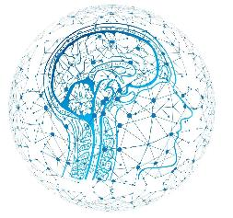
UNIT 1 How can we think critically?​
"The important thing is not to stop questioning. Curiosity has its own reason for existing."—Albert Einstein
​
​
​
1. How do we think critically?​
1.1. Critical thinking skills
1.2. Useful questions
​
​
​

Slide 5
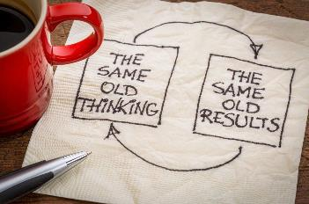
UNIT 1 How can we think critically?​
1.1. Critical thinking skills
“With the new day comes new strength and new thoughts. ”
Eleanor Roosevelt
good reasons
sound evidence
depth
accuracy
clarity
precision
fairness
breadth
relevance
consistency

Slide 6
UNIT 1 How can we think critically?
Someone with critical thinking skills can:
​
understand the links between different ideas
identify, judge and build arguments
determine the importance and relevance of ideas and arguments
identify errors and inconsistencies in reasoning
approach problems in a consistent and orderly manner
reflect on their own assumptions, beliefs and values
​
https://www.skillsyouneed.com
​
​

Slide 7
UNIT 1 How can we think critically?​
When we use critical thinking we:
use a number different advanced thinking skills
put focus on the thought itself, we look at how the arguments and facts are formed
reflect on and question our own thinking processes
are open minded and consider alternatives and other points of view
look deeper and farther
ask questions on: sound evidence, good reasons, depth, breadth, fairness
​

Slide 8
UNIT 1 How can we think critically?​
1.2. Useful questions
Be open to different perspectives
We can train our critical thinking as any other muscle and doing so resilience and curiosity are key.
Here are some useful questions:

Slide 9
UNIT 1 How can we think critically?
What are the reasons?
How good is the quality of the argument:
What are the issue and the conclusion?
What are the assumptions?
How good is the evidence?
Are there any fallacies in the reasoning?

Slide 10
UNIT 1 How can we think critically?
1.2. Useful questions
What are the issue and the conclusion?
How can we define the problem?
What is happening?
What are keywords?
Why is it important? Who would be affected by this?
Who is the implied audience?

Slide 11
UNIT 1 How can we think critically?
1.2. Useful questions
What are the reasons?
What are the main ideas?
What is the relationship between this and that?
What are the strengths and weaknesses of this?
What information am I missing?

Slide 12
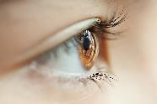
UNIT 1 How can we think critically?
1.2. Useful questions
What are the assumptions?
What are the underlying assumptions and values?
How do you know what you think you know?
How would your perspective be different if you were on the opposing side?
What's another way to look at this?

Slide 13
UNIT 1 How can we think critically?
1.2. Useful questions
How good is the quality of the argument:
Is opinion or bias present in the information?
What is the author’s purpose for sharing this?
Is the author a credible and with experience with this subject?
Is it fact or is it opinion?

Slide 14
UNIT 1 How can we think critically?
1.2. Useful questions
Are there any fallacies in the reasoning?
What exactly is the logical flaw in this reasoning?
What is irrelevant or unnecessary, and can be ignored or discarded?
What am I missing?

Slide 15
UNIT 1 How can we think critically?
1.2. Useful questions
How good is the evidence?
Who is saying it?
Is it accurate?
Is it fact-based?

Slide 16
UNIT 1 How can we think critically?
1.2. Useful questions
Drawing Conclusions
Do you agree or disagree — and why?
What else? What if?
What solutions can we create to this problem?

Slide 17
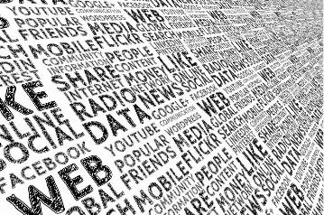
UNIT 2 Critical Thinking in a digital era
“Whoever controls the media, the images, controls the culture.”
Allen Ginsberg​
​
2. Critical thinking in a digital era
2.1. Critical thinking, images and media
2.2. Online false information
​
​

Slide 18
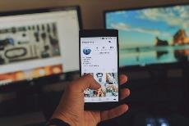
UNIT 2 Critical thinking in a digital era
4. 1. Critical thinking, images
and media
In our culture today a huge proportion of the information
we are exposed to is:
image-based not word-based
screen-based not paper-based
We have to be aware on how the images affect us
and use our critical thinking and take a second look.

Slide 19
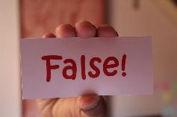
UNIT 2 Critical thinking in a digital era
2.1. True or False (Fake News)
“The internet is a wonderful repository of human knowledge, but it is also a vast and daunting sea of information. Being able to navigate it and making critical judgements on the quality of information you come across and whether to trust it are essential skills in the digital environment” - Dr Alison Pickard
False information is news, stories or hoaxes created to deliberately misinform or deceive readers

Slide 20
UNIT 2 Critical thinking in a digital era
Type of false information​
​
​
​
​
Clickbait
– to gain more website visitors and increase advertising revenue for websites
Propaganda
– to mislead audiences, promote a biased point of view
Satire/Parody
- for entertainment and parody
Sloppy journalism
– unreliable information or without checking all facts
Misleading headings
– can spread quickly on social media sites
Biased/slanted news
– many people are drawn to news or stories that confirm their own believes and biases and fake news can pray on these biases
Source

Slide 21
UNIT 2 Critical thinking in a digital era
How to spot false information​
​
Take a closer look
Look beyond the headline
Check other sources
Check facts
Check your biases
Is it a joke?
​

Slide 22
UNIT 2 Critical thinking in a digital era
Media Literacy​
​
Media Literacy is the ability to identify different types of media and understand the messages they are sending and understand the reason why it was created.
Media is not only newspapers, webpages, television and movies. It is also things like text messages, memes, viral videos, social media, video games, advertising and more.
​

Slide 23
UNIT 2 Critical thinking in a digital era
Digital Media Literacy​
​
Digital media literacy addresses three types of online content:
Misinformation, is false, but not created or shared with the intention of causing harm
Malinformation, is based on a fact, but used out of context to mislead, harm or manipulate
Disinformation, is deliberately created to mislead, harm or manipulate a person, social group, organization or country
​
Source

Slide 24
Consider the source
Triple check the source
Identify the author
Sites designed to spread false information often try to mimic legitimate news sources. You could check the name, logo, and "About" section to verify.
Misleading and false articles often do not include authors. If authors are listed, do a quick search to see if they are trusted source.
Inspect the URL
Webpages that notoriously spread disinformation often have odd web domain names that try to imitate real sources.
Is this a well-known or trusted source?
Key steps
for digital media literacy​
Source

Slide 25
Examine spelling and punctuation
Seek alternative viewpoints
Webpages with misspelled words, unnecessary ALL CAPS, poor grammar, and excessive punctuation are often unreliable.
Search for other articles and sources on the same topic. If there are limited or no results, or you find contradicting information, you may want to do further research and fact-checking.
Think before you share
Damaging disinformation spreads quickly via shared posts. Emotional and sensitive topics are often used to manipulate readers into sharing without thinking. Review the above steps and be wary of content that seeks to sow discord and provoke audiences.
Key steps
for digital media literacy​
Source

Slide 26
Self-assessment test
1. When we use critical thinking
We put focus on the thought itself
We know the right answers
We know that everything is important
2. Useful questions for critical thinking are:
What have I always thought about this?
What are the underlying assumptions and values?
What do I feel is the right answer?
3. With visual material it is always important to:
Be aware on how the images affect us
Know they are always right
Believe what you see

Slide 27
Self-assessment test
4. We can spot false information
as they are always easy to recognize
by checking other sources
as they are not what we would like to see
5. Digital media literacy​ means:
Knowing what there is online
The ability to identify different types of media and understand the messages they are sending. ​
Reading online material

Slide 28
Practical Tips
3
TIP 3 Useful questions can help such as: How can we define the problem? What are the reasons? What are the assumptions?​
How good is the quality of the argument?
​
1
TIP 1 When we use critical thinking we reflect and question our own thinking processes
2
TIP 2 When we use critical thinking we are open minded and consider alternatives and other points of view
4
TIP 4 We have to be aware on how images affect us ​and use our critical thinking and take a second look.
5
TIP 5 How to spot false information​​: Take a closer look​; Look beyond the headline​; Check other sources​; Check facts​; Check your biases​; Is it a joke?
6
TIP 6
Consider the source and author
Inspect the URL
Think before you share

Slide 29
Thanks!
Any questions?

